Slide 1
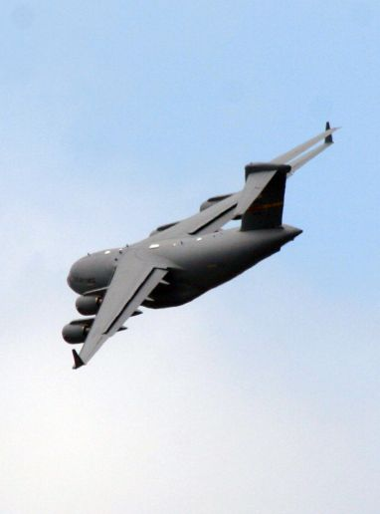
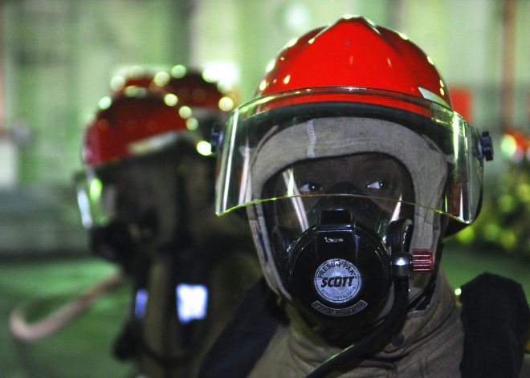
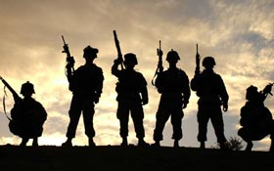
Hero’s Project
Due Monday 9/12/11
Names:

Slide 2
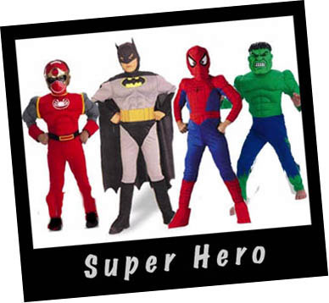
Super Heroes
Name
AKA
Strengths/Weaknesses
Sidekick
How did they get their strength?
Why did you choose this hero?
How are you like this Hero?

Slide 3
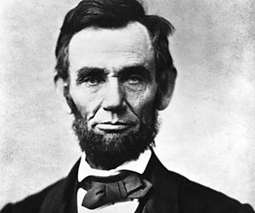
Historical
Name
AKA
Time Period
Why was this person considered a Hero?
How are you like this person?

Slide 4
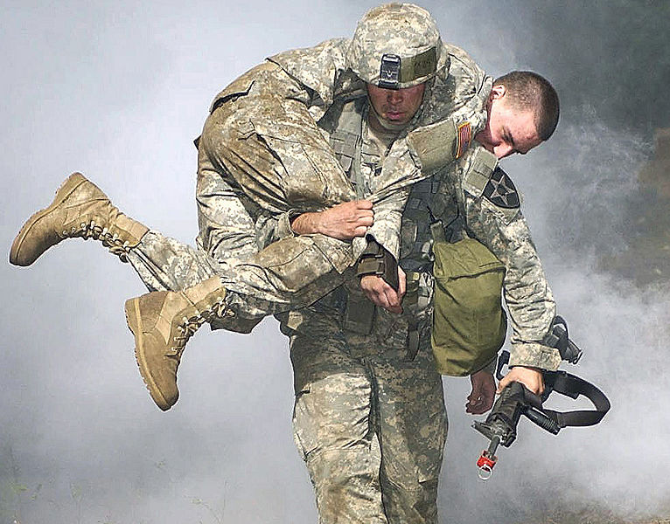
Real Life Hero
Name
AKA
Why was this person considered a Hero?
How are you like this person?

Slide 5
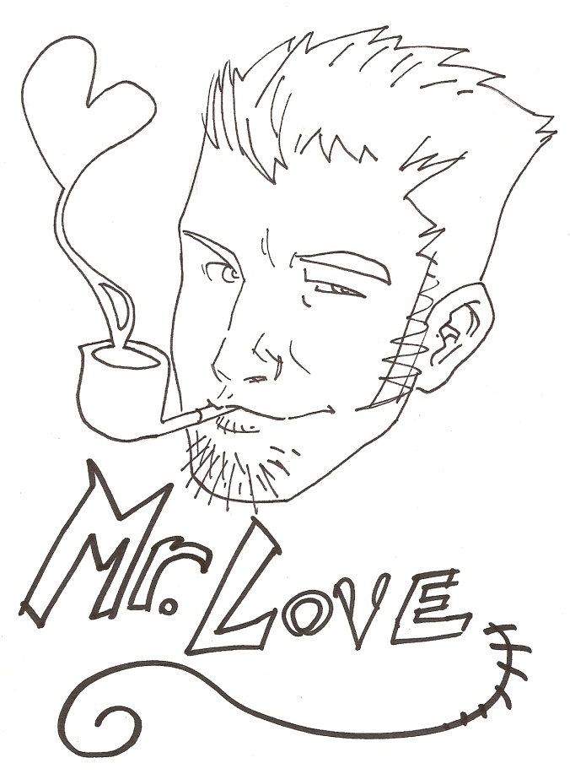
Hero in Me
What Heroic deed have you done to be considered a hero by others?

